Slide 1
Home security system with Intruder Alert using Computer Vision
A project submitted in fulfillment of the requirements of the PG Program in Artificial Intelligence & Machine Learning
Sivakumar Panneerselvam
Anton Erone Pius
Hariharan Ramesh
Jayaseeli Joachin
Arun P
November 2020

Slide 2
Problem Definition
Access, security and safety
Average 2.5 million burglaries happen every year(one burglary every 13 seconds) and 88% are residential in nature : Burglary statistics US
Only 13% of the reported burglaries are solved due to lack of evidence : FBI report
Most effective deterrents are CCTV camera : The Guardian

Slide 3
Existing CCTV solutions
Captures and records : evidence collection, document events
Live video stream needs people resource
Intelligent Security Solution
Helps to identify and interrupt security breaches, as they are occurring
Integration with intrusion and access control
Provides liveness checking

Slide 4
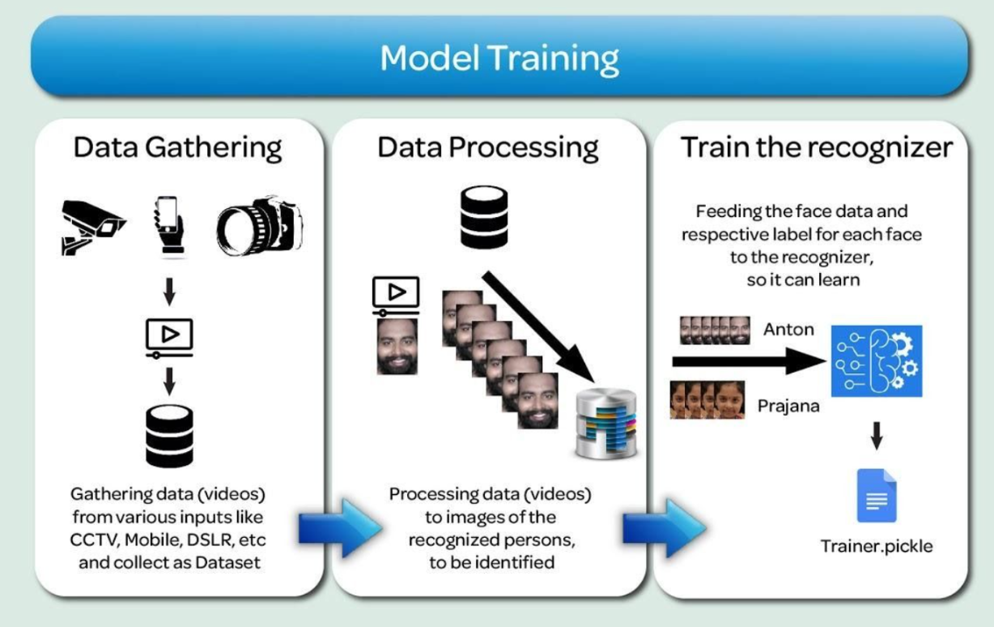
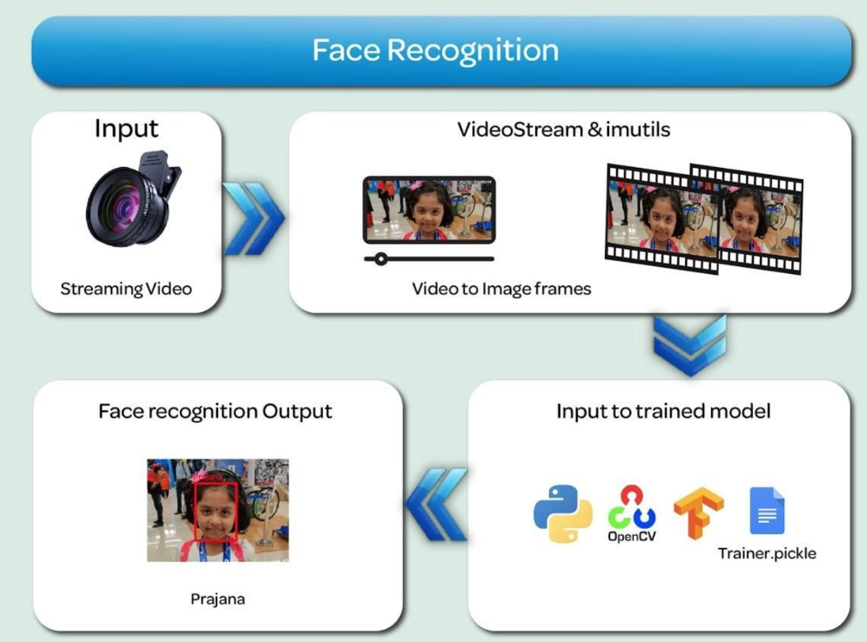
SOLUTION : A Unified intruder alert system with Face Recognition

Slide 5
Dataset
Pre-trained Face Detection Caffe model used WIDERFACE benchmark dataset
32,203 images
61 event classes
393,703 faces with bounding boxes [l, t, w, h]
Expressions, pose, illumination
Input dataset
Real images and fake images of person standing in front of the camera.
Output dataset
Face liveness dataset from known faces
Extracted, cropped , Face ROIs

Slide 6
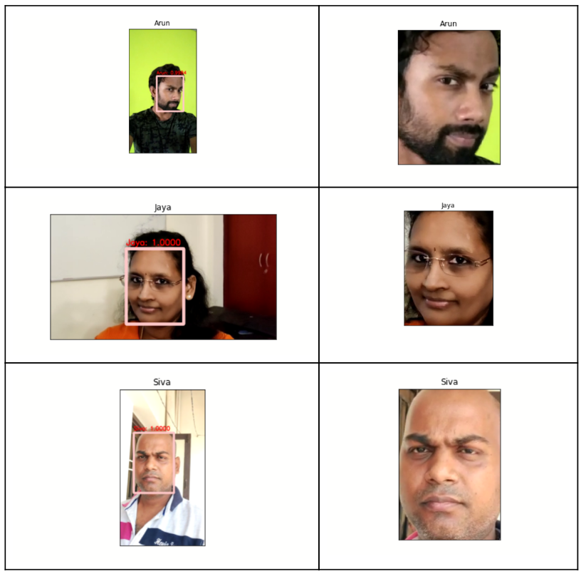
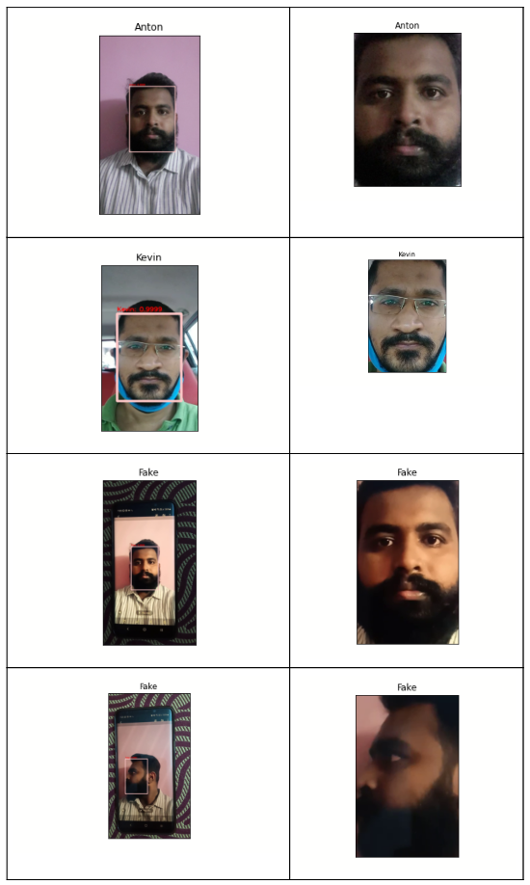

Slide 7
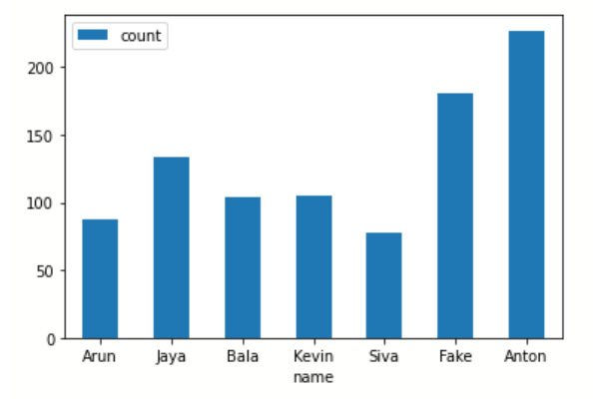
Count of Dataset per person created when converting videos into individual frames

Slide 8
Algorithm
Create Deep Learning Facial dataset
Record videos of real persons
Play the same and capture video for fake
Generate frames
Face Detection model training with frames
Extract Face features
Generate Face liveness dataset – Face ROIs
CNN for liveness detection
Implement two blocks of CONV =>RELU=>CONV=>RELU=>POOL layers
Add FC=>RELU layer
Use Softmax classifier

Slide 9
Train the liveness detector
Extract data from images
Extract labels from filename
Apply Image augmentation
Random rotate, zoom, flip, shift
Initialize liveness detection model
Compile and train
Predict and evaluate
Face recognition at real time
Capture face at real time
Apply face detection to each frame
Supply the extracted data to the tensorflow model

Slide 10
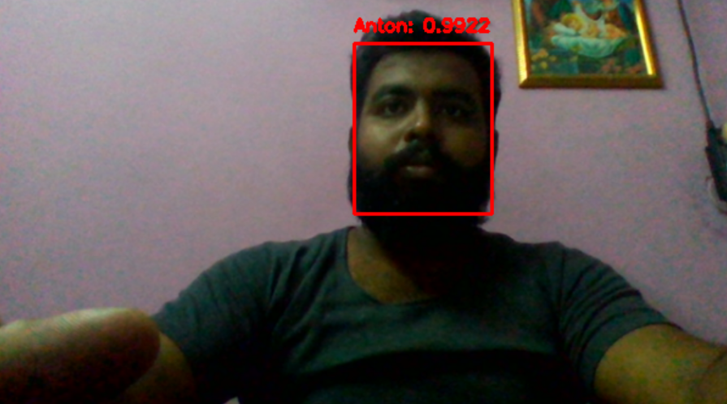
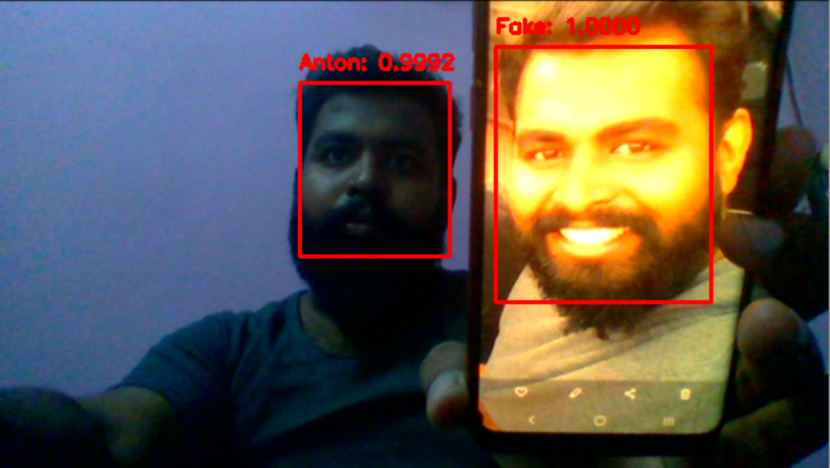
Face Detection and Recognition from a webcam

Slide 11
Conclusion
Recognizes real and fake with good accuracy
Less training data
Contactless
Can be extended for other use cases like, surveillance in large crowded areas, etc,.
Enhancements
Slack Communication channel.
Supporting multiple camera inputs.
App Support for remote controlling features.

Slide 12
Demo

Slide 13
Thank you

